Slide 1
Vigenere Cipher
Dr.A.Neela Madheswari
Professor
Mahendra Engineering College

Slide 2

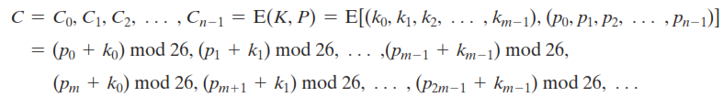
Vigenere Cipher
Polyalphabetic cipher
Plain text denoted by P
Key denoted by K
Cipher text denoted by C

Slide 3


Encryption & Decryption process

Slide 4

Example

Slide 5
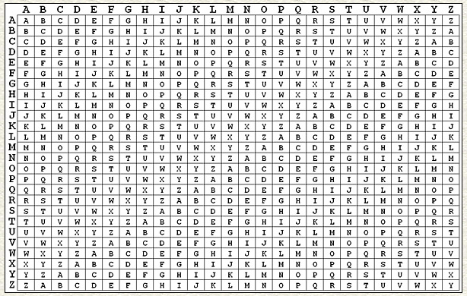
Vigenere table

Slide 6
keyword | d | e | c | e | p | t | i | v | e
Plaintext | w | e | a | r | e | d | i | s | c
Ciphertext | z | i | c | v | t | w | q | n | g

Slide 7
keyword | d | e | c | e | p | t | i | v | e
Ciphertext | z | i | c | v | t | w | q | n | g
Plaintext | w | e | a | r | e | d | i | s | c

Slide 8
Vigenere Cipher
Aim:
To implement a program for encryption and decryption using vigenere cipher
Algorithm:
Arrange the alphabets in row and column of a 26x26 matrix
Circulate the alphabets in each row to position left such that the first letter is shifted to last
Repeat this process for all 26 rows and construct the final key matrix
The keyword and plain text is read from the user
The characters in the keyword are repeated sequentially so as to match with that of the plain text
Pick the first letter of the plain text and that of the keyword as the row indices and column indices respectively
The junction character where these two meet forms the cipher character
Repeat the above steps to generate the entire cipher text
Pick the first letter of the keyword as the row index and select the corresponding cipher text in that row. Then the starting letter of that column is our plain text
Repeat the above steps to generate the entire plain text

Slide 9
Program
import java.util.Scanner;
public class VigenereCipher1
{
public static void main(String[] args)
{
int c=0, input;
System.out.println("----Vigenere Cipher Encryptor----\n");
Scanner in = new Scanner(System.in);
while(c<2)
{
System.out.println("- Press 1 to encrypt a message / Press 2 to decrypt a message - ");
input = in.nextInt();

Slide 10
Program
if (input == 1)
{
System.out.print("Enter the key in UPPER Case: ");
String key = in.next();
System.out.print("Enter the message that would like to be encrypted by Vigenere cipher: ");
String EMessage = in.next();
String encryptMessage = encrypt(EMessage, key);
System.out.println("The encrypted message is: " +
encryptMessage);
c++;
}

Slide 11
Program
else if (input == 2)
{
System.out.print("Enter the key in UPPER Case: ");
String key = in.next();
System.out.print("Enter the message that would like to be decrypted by Vigenere cipher: ");
String DMessage = in.next();
String decryptMessage = decrypt(DMessage, key);
System.out.println("The decrypted message is: " + decryptMessage);
c++;
}
else
{
System.out.println("Wrong Input!");
}

Slide 12
Program
}
in.close();
}
public static String encrypt(String Message, String Key)
{
String EMessage = "";
Message = Message.toUpperCase();
for (int i = 0, j = 0; i < Message.length(); i++)
{
char letter = Message.charAt(i);
EMessage += (char)(((letter - 65) + (Key.charAt(j)-65)) % 26 + 65);
j = ++j % Key.length();
}
return EMessage;
}

Slide 13
Program
public static String decrypt(String Message, String Key)
{
String DMessage = "";
Message = Message.toUpperCase();
for (int i = 0, j = 0; i < Message.length(); i++)
{
char letter = Message.charAt(i);
DMessage += (char)((letter - Key.charAt(j) + 26) % 26 + 65);
j = ++j % Key.length();
}
return DMessage;
}
}

Slide 14
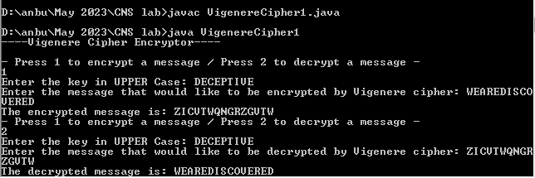
OUTPUT

